Slide 1
Data Science Group Project: Cropland Classification
Ritwik Harit, 2021557
Vasan Vohra, 2021572
Aditya Jain, 2021511
Vasu Kapoor, 2021573

Slide 2
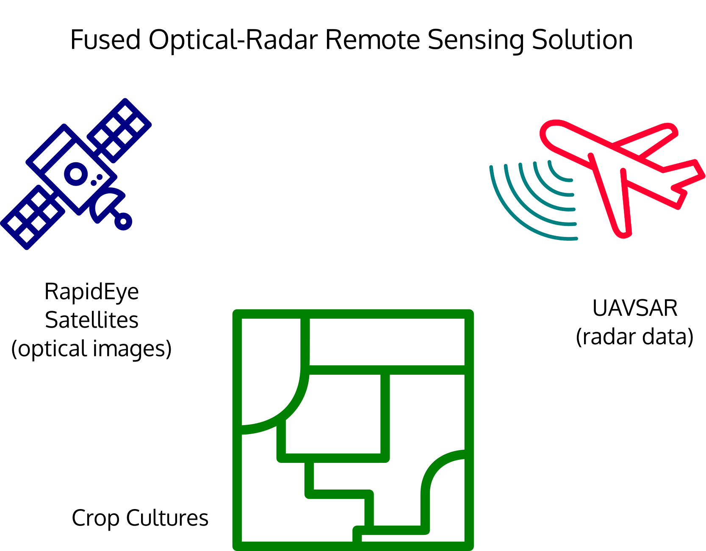
Problem Statement
Our goal is to perform a detailed data analysis, utilizing methods such as correlation analysis, t- Test and Recursive Feature Elimination (RFE) to precisely classify crops among seven classes, using a dataset of 325,834 observations and 175 attributes.
The importance of our problem statement lies in its potential to enhance crop classification accuracy, which is vital for informed agricultural decision-making and resource optimization, ultimately contributing to increased agricultural productivity and sustainability.

Slide 3
Timeline
Data Exploration and Analysis
Preprocessed the data to ensure consistency and quality and conducted initial exploratory data analysis to understand the data structure and characteristics.
Data Preprocessing
Handled duplicate rows and missing values.
Standardised numerical features.
Removed Outliers.
Feature Removal
Used Correlation Heatmap to remove highly correlated features.
Performed Dimensionality reduction (using RFE).
Model Selection, Training and Evaluation
Used Complex models like MLP, XGBoost classifier, random forest classifier, k-NN for classification.
Trained the selected model using the training dataset.
Evaluated the model using appropriate metrics (Accuracy).
Model Optimisation
Optimised hyperparameters using the validation dataset.
Presentation
Created a comprehensive presentation summarising the project's objectives and methods.

Slide 4
Dataset Details
The Cropland mapping dataset was meticulously curated by integrating optical and remote sensing imagery, incorporating numerous temporal, textural, and polarimetric features.
The dataset contains 3,25,834 rows and 175 columns, including 174 distinct features and 1 target column.
The dataset is specifically designed for a classification task where the target variable exhibits seven distinct values: 1, 2, 3, 4, 5, 6, and 7.
The dataset consists of:
1. Class (Target Label)
2. Polarimetric Features on 05 July 2012 (f1 to f49)
3. Polarimetric Features on 14 July 2012 (f50 to f98)
4. Optical Features on 05 July 2012 (f99 to f136)
5. Optical Features on 14 July 2012 (f137 to f174)

Slide 5
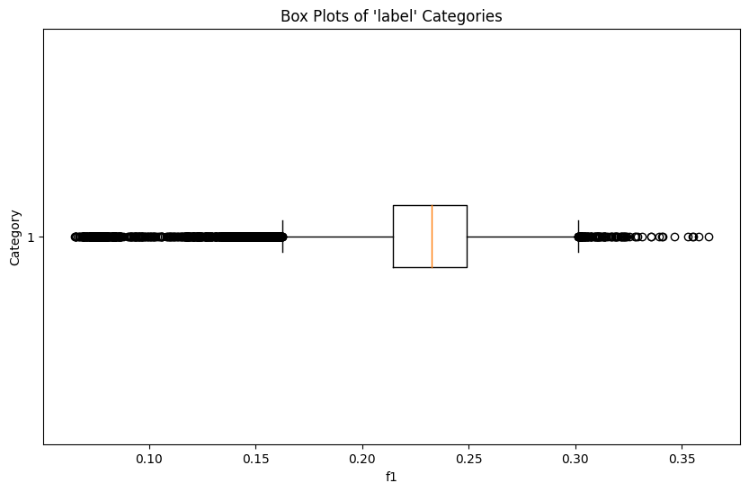
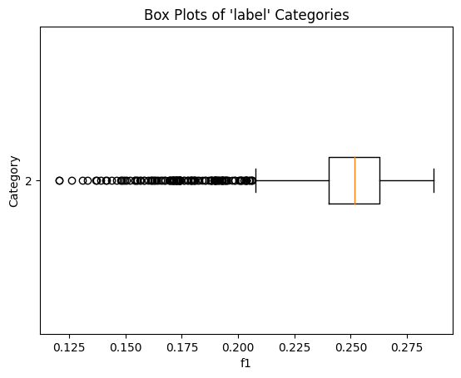
Dataset Details
We generated boxplots for various features, each associated with specific label categories. During our analysis, we noticed the presence of a substantial number of outliers (approximately 10,000). These outliers stand out prominently and have the potential to significantly impact the dataset by introducing variations and deviations from its typical distribution.

Slide 6
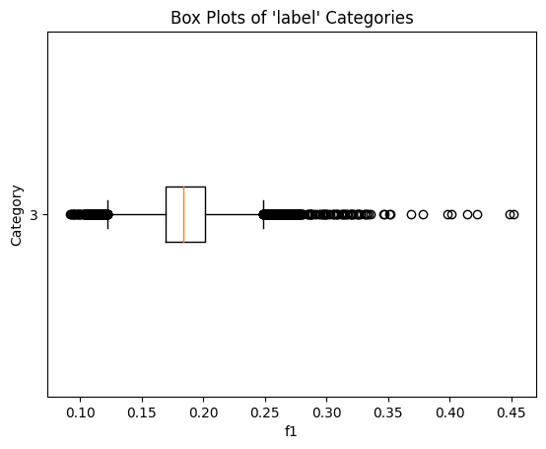
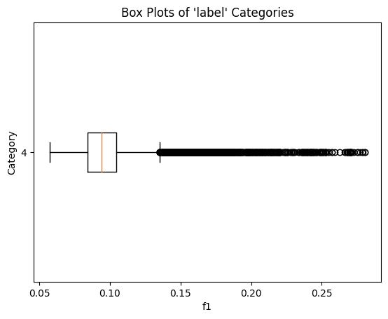
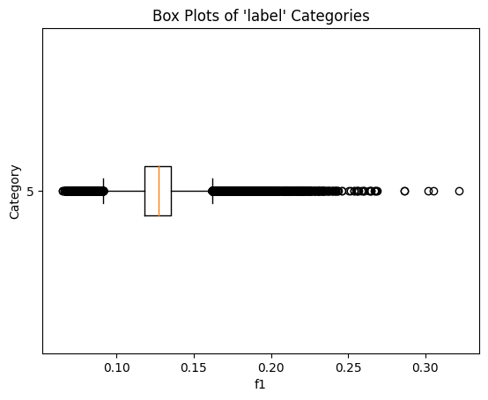
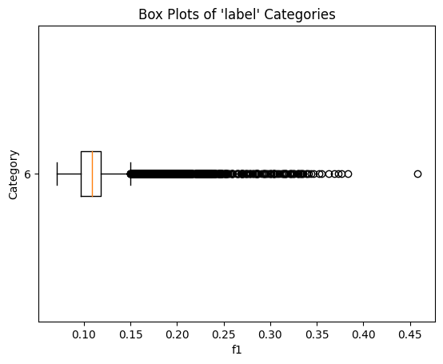
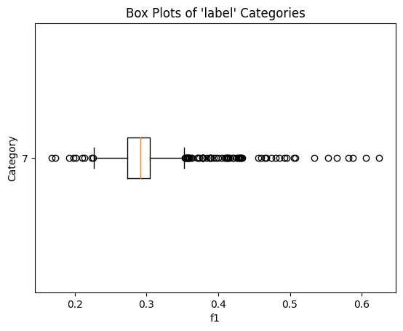
Dataset Details

Slide 7
Challenges
Feature Selection: Since the dataset contains 175 attributes, feature selection is a crucial task. We must carefully identify which features are relevant for predicting the crop class and which features can be discarded.
Feature Engineering and Scaling: We will have to transform or create new features to improve the model's performance. We will have to apply standardisation techniques, which is an essential preprocessing step to ensure that all features have the same scale.
Imbalanced Classes: We must treat imbalanced classes as they can lead to biased models that perform poorly on minority classes.
Data Exploration and Visualisation: For a large dataset, effectively exploring and visualising the data to gain insights and identify patterns and trends can be a complex task.
Outlier Removal: Using appropriate techniques for outlier removal is crucial because outliers can skew statistical analysis, affect model performance, and lead to misleading insights.
Model Selection: Choosing an appropriate classification algorithm for this dataset is crucial. We must experiment with various algorithms and tune their hyperparameters, which can be time-consuming and computationally expensive.

Slide 8
Preprocessing
Handling Null Values: Rows containing Null values were removed from the dataset to ensure data integrity and prevent potential bias in the analysis.
Eliminating Duplicate Rows:Duplicate rows were identified and removed from the dataset to avoid redundancy and ensure the accuracy of the analysis.
Outlier removal: Outliers were removed from the dataset because have the potential to significantly impact the dataset by introducing variations and deviations from its typical distribution. Over 9000 outliers have been removed and the method used is Isolation Forest.
Standard Scaling: Standard scaling was used to standardise the data. Standardisation helps ensure that features with different units and scales do not disproportionately influence the modelling process and helps machine learning algorithms converge faster.
Feature Removal: Features exhibiting a high correlation, represented by a correlation coefficient greater than 0.90, were identified and removed. This step helps in improving the machine learning model interpretability and generalisation.
Recursive Feature Elimination (RFE): We applied RFE to reduce the feature set from 78 to an optimised subset of 60. This decision was informed by an accuracy analysis, as depicted in the accuracy VS number of features graph, which demonstrated that the model attained its peak accuracy with 60 features.

Slide 9
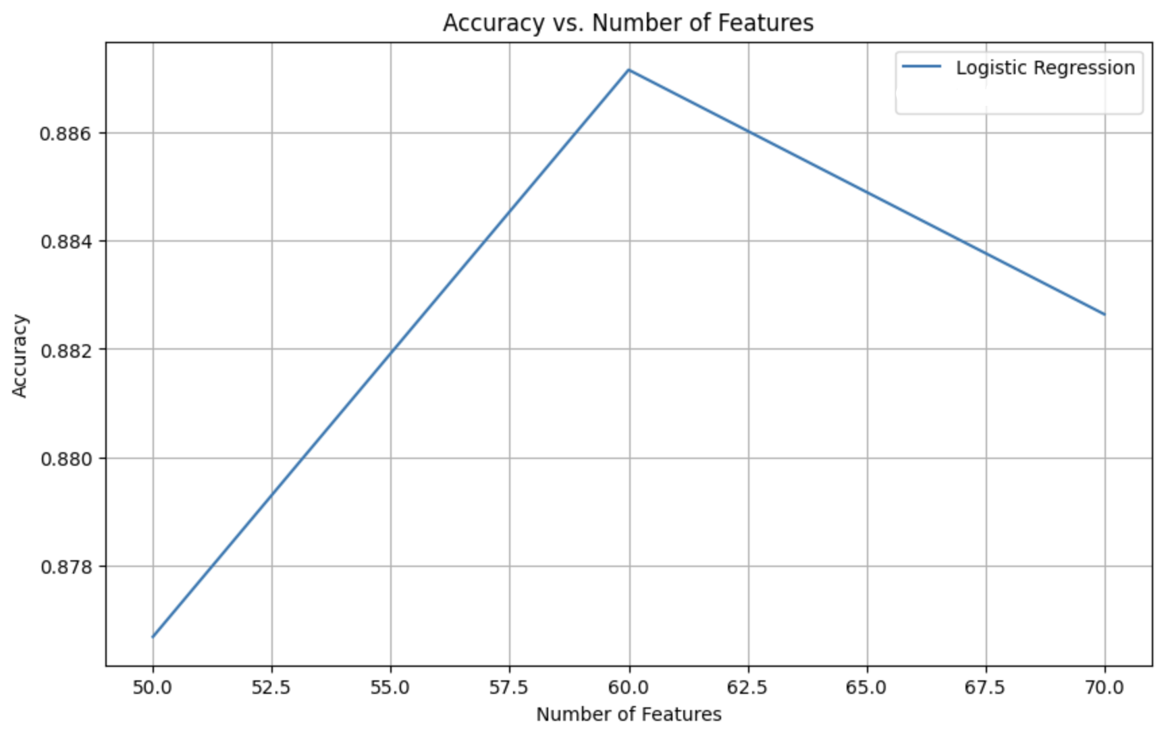
Accuracy vs Number of Features

Slide 10
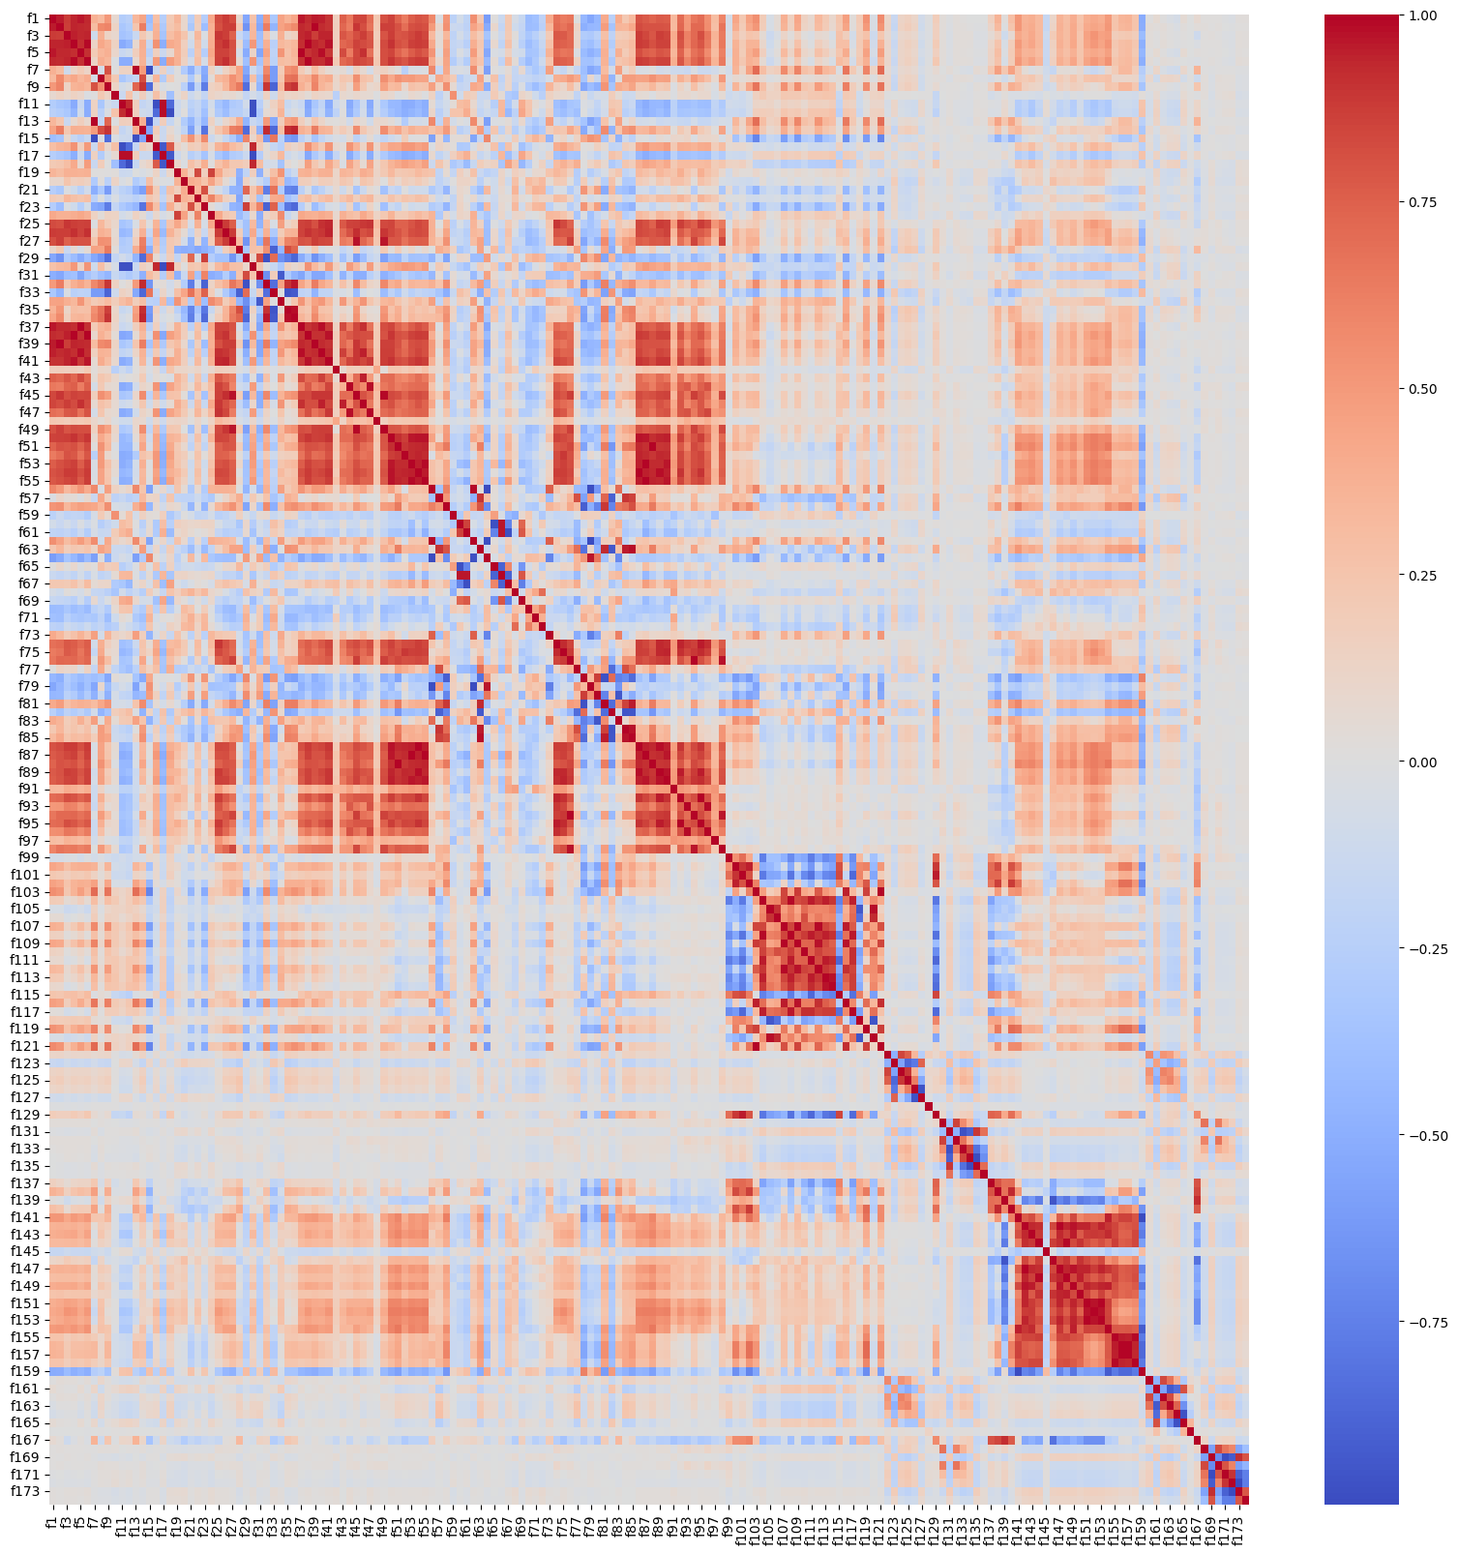
Correlation Heatmap

Slide 11
Methodology
Data Cleaning and Exploration: We removed rows containing missing values to ensure data integrity. We eliminated duplicate rows to enhance data reliability. Outliers have been removed. Extensive data visualisation was performed by using scatter plots, histograms, box plots, and line graphs. These visualisations helped in understanding the dataset's characteristics and trends.
Feature Selection: To streamline the dataset, we generated correlation heatmaps. Features exhibiting a high correlation coefficient (greater than 0.90) were identified and subsequently removed. This process led to the removal of 96 highly correlated features.
Skewness Assessment: We computed the Bowley coefficient for all features. This provided valuable insights into the skewness of each feature distribution, aiding in understanding the data's asymmetry and central tendencies.
Recursive Feature Elimination (RFE): We used RFE to reduce the number of features to 60. This process improved efficiency, increased interpretability, and lowered computational complexity in our analysis.
Model Predictions: We used different models for the predictions and the results are provided on the next slide.

Slide 12
Model Accuracies
The Table below displays the accuracies of various models
Model | Accuracy
Decision Tree Classifier | 0.9803581567357712
Multinomial Logistic Regression | 0.9856369021130327
Random Forest Classifier | 0.991161170531097
K Nearest Neighbours | 0.9877698835300075
MLP Classifier | 0.993048628907269
XGB Classifier | 0.9928031058664661
Bagging using base estimator as Logistic | 0.9530823372332104
AdaBoost Classifier | 0.9734000401228903
The Model which provides the best accuracy is the MLP Classifier.

Slide 13
Hypothesis Testing
The features f1-f98 represents the features obtained by the UAVSAR system (Radar) and f99-f174 features represents the features that are obtained by the RapidEye satellites(optical). We splitted the dataset into radar and optical components and used a number of models to test if there is a significant difference between radar and optical accuracies. We used 40% of data as sample to train and 20% to test. We used the remaining 40% data to validate the experiment.
 | Accuracy
Models | Radar | Optical
Decision Tree Classifier | 0.9621 | 0.9298
Multi-class Logistic Regression | 0.9511 | 0.6795
Random Forest Classifier | 0.9815 | 0.9570
K-Nearest Neighbours | 0.9804 | 0.6981

Slide 14
Hypothesis Testing
We decided to do paired t-test because in our dataset we had directly related observations which are the accuracy scores of optical and accuracy scores of radar and paired t-tests are ideal for comparing two related groups, such as two different methods applied to the same samples.
We took the two-tailed test with significance level as 0.05.
H0: There is no significant difference between optical and radar accuracies. (Null hypothesis)
H1: There is a significant difference between optical and radar accuracies. (Alternative hypothesis)
Taking the values from the previous table we have the p-value as 0.123.
Since this value is greater than the significance level we say that we do not have enough evidence to reject the Null Hypothesis and say that there is no significant difference between optical and radar accuracies.

Slide 15
Hypothesis Testing
Validating the experiment Hypothesis Test
We finally validated our experiment by training the data on 80% of the dataset and training on the remaining 20%. We concluded that the values given by this is also similar to values we receive on the full dataset is also similar to the ones we already have.
We can say that the same result follows here.
 | Accuracy using full dataset |  | Accuracy using partial dataset
Models | Radar | Optical | Radar | Optical
Decision Tree Classifier | 0.9696 | 0.9298 | 0.9621 | 0.9298
Multi-class Logistic Regression | 0.9510 | 0.6795 | 0.9511 | 0.6795
Random Forest Classifier | 0.9863 | 0.9570 | 0.9815 | 0.9570
K-Nearest Neighbours | 0.9860 | 0.6981 | 0.9804 | 0.6981

Slide 16
Hypothesis Testing
We also decided to do a KS-test and t-test for the same features measured on two different days. Since the same features were observed on the two different dates, it only makes it right to test whether these features are similar or not. We picked some pair of features and conducted t-tests to see whether the features are same or not and KS-test to see whether their distribution is same or not on 0.1% of the samples. We then validated this by testing these features on all samples
For t-test
H0: There is no significant difference between the feature means. (Null hypothesis)
H1: There is a significant difference between the feature means. (Alternative hypothesis)
We took the two-tailed test with significance level as 0.05.
Features | p value on 1% data | Conclusion | p value on all data | Conclusion
f1, f50: SigHH_Rad | 9.67e-10 | Reject H0 | 0 | Reject H0
f2, f51: SigHV_Rad | 9.98e-10 | Reject H0 | 0 | Reject H0
f10, f59: Rrrll_Rad | 0.53 | Accept H0 | 4.47e-20 | Reject H0

Slide 17
Hypothesis Testing
For KS-test
H0: There is no significant difference between the feature distribution. (Null hypothesis)
H1: There is a significant difference between the feature distribution. (Alternative hypothesis)
We took the two-tailed test with significance level as 0.05.
Features | p value on 1% data | Conclusion | p value on all data | Conclusion
f1, f50: SigHH_Rad | 1.85e-12 | Reject H0 | 0 | Reject H0
f2, f51: SigHV_Rad | 5.4e-13 | Reject H0 | 0 | Reject H0
f10, f59: Rrrll_Rad | 0.39 | Accept H0 | 0 | Reject H0

Slide 18
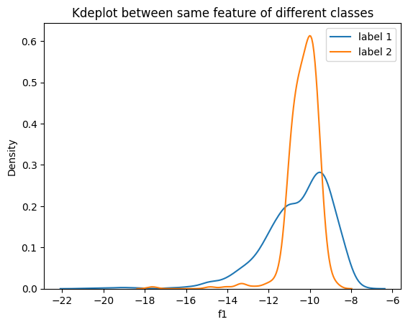
Hypothesis Testing
We also decided to do a KS-test for the same features measured on two different classes. We wanted to compare if there is a significance difference between the values of the features between 2 different classes. We plotted the Kdeplot by sampling on 10% of data to check the distribution of the values of the feature and conducted KS-tests to see whether the features are same or not. We then validated this by testing these features on all samples.
For KS-test
H0: There is no significant difference between the
feature distributions. (Null hypothesis)
H1: There is a significant difference between the
feature distributions. (Alternative hypothesis)
We took the two-tailed test with significance level as 0.05.
Features | p value on 10% data | Conclusion | p value on all data | Conclusion
f1: SigHH_Rad | 4.35e-23 | Reject H0 | 2.15e-233 | Reject H0
f12: Rrrll_Rad05July | 1.08e-107 | Reject H0 | 1.068e-217 | Reject H0
f59: Rrrll_Rad | 4.3e-107 | Reject H0 | 0 | Reject H0

Slide 19
References
Cropland Mapping Dataset
Code
Hypothesis Testing Code

